Slide 1
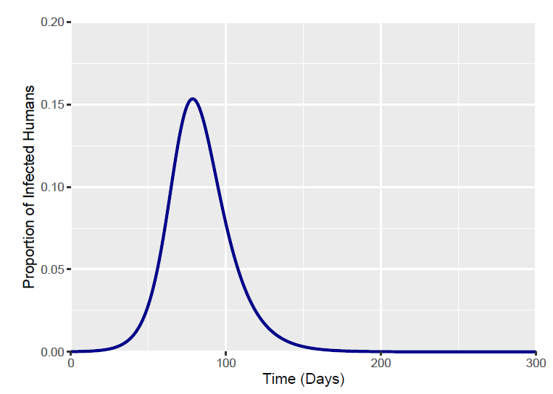
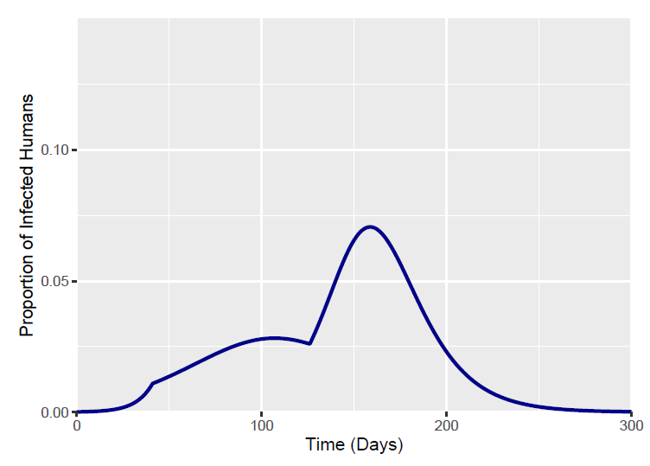
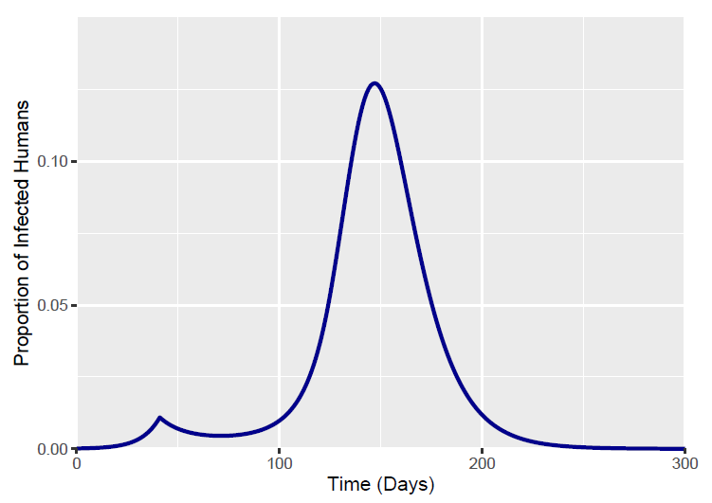
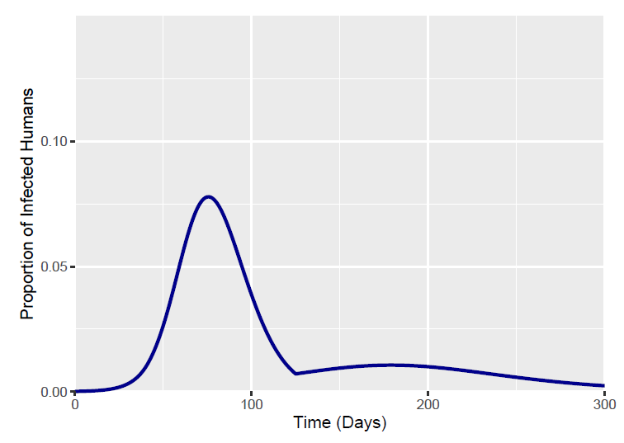
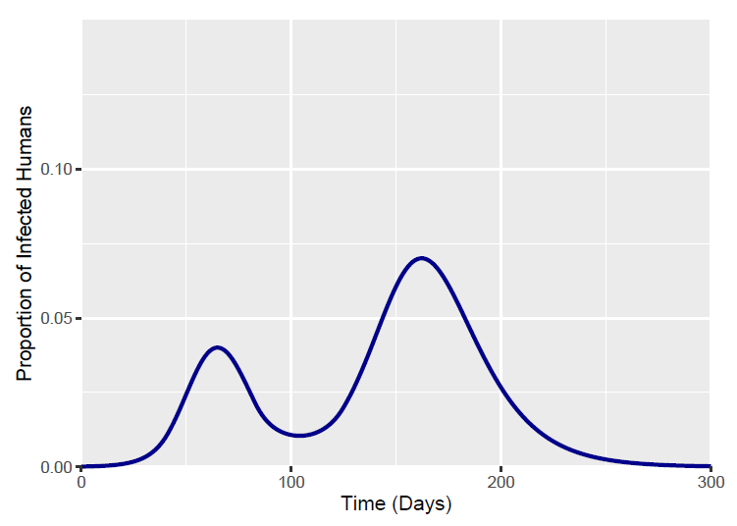
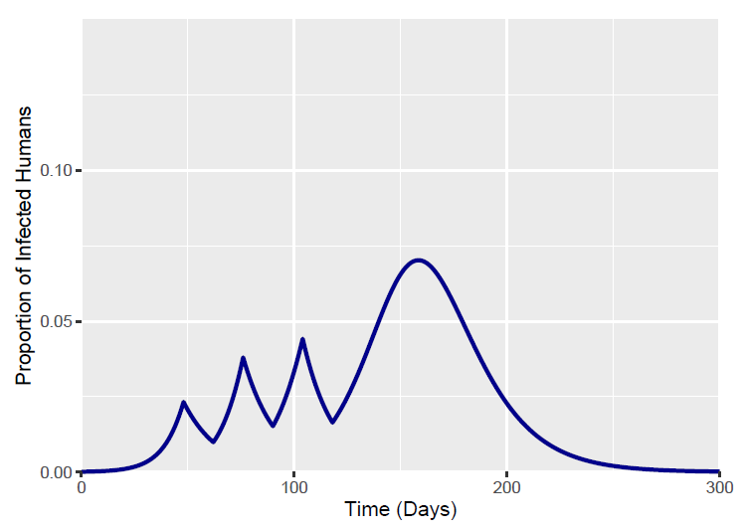
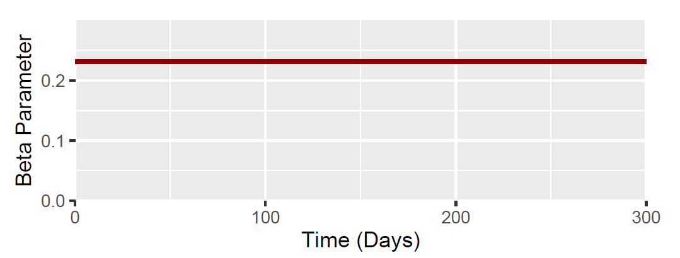
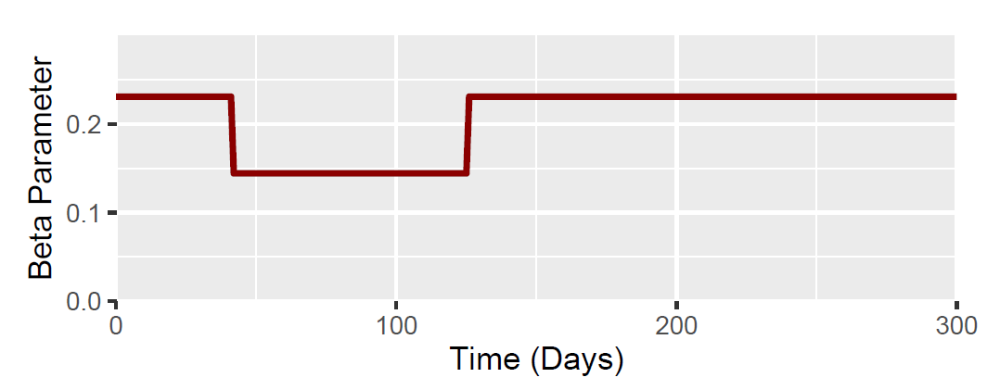
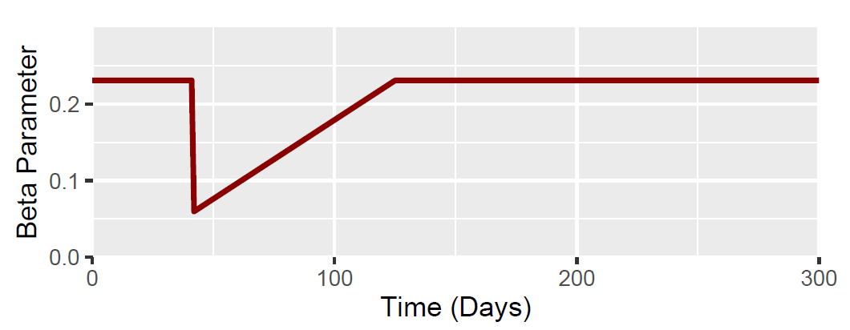
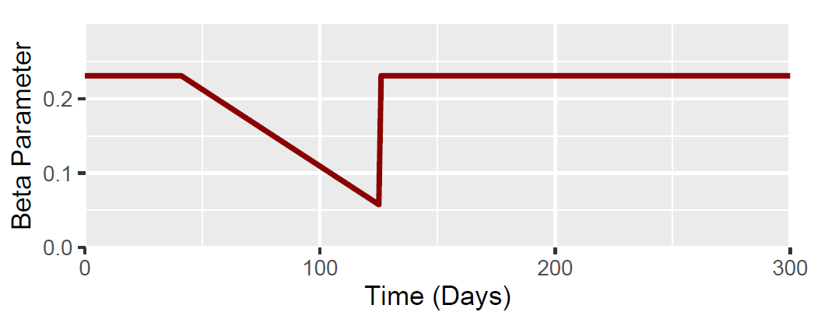
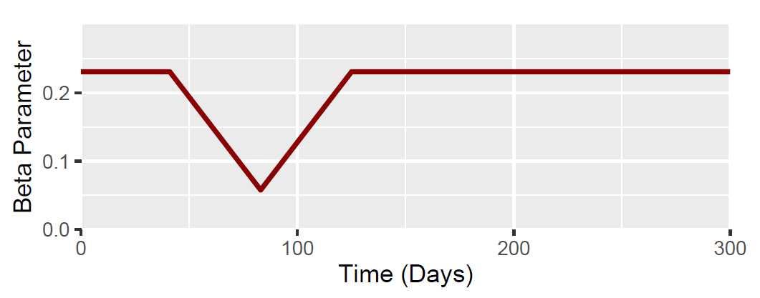
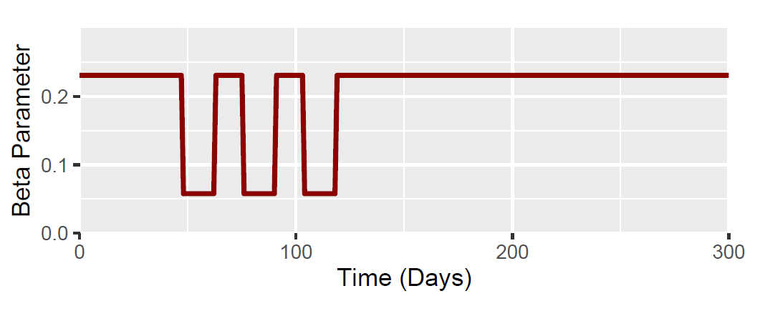
Summary table
Output Measures | Baseline | Scenario 1 | Scenario 2 | Scenario 3 | Scenario 4 | Scenario 5
Total Fraction Infected | 0.797 | 0.721 | 0.777 | 0.585 | 0.720 | 0.720
Peak Fraction Infected | 0.153 | 0.071 | 0.127 | 0.078 | 0.070 | 0.070
Time of Epidemic Peak | Day 79 | Day 159 | Day 147 | Day 76 | Day 162 | Day 158
Proportion Infected:
Beta:

Slide 2
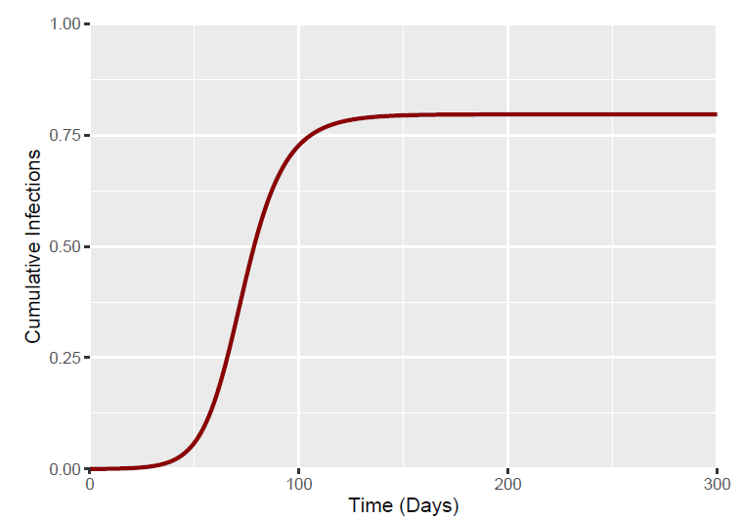
BASELINE – No Alteration to the β Parameter
Output Measures | Value
Total Fraction Infected | 0.797
Peak Fraction Infected | 0.153
Time of Epidemic Peak | Day 79
Initial Conditions
S = 0.9999
I = 0.0001
R = 0
Doubling Time = 6
R₀ = 2
β = 0.231
Time of I = 0.01
Day 41 (I = 0.0109)

Slide 3
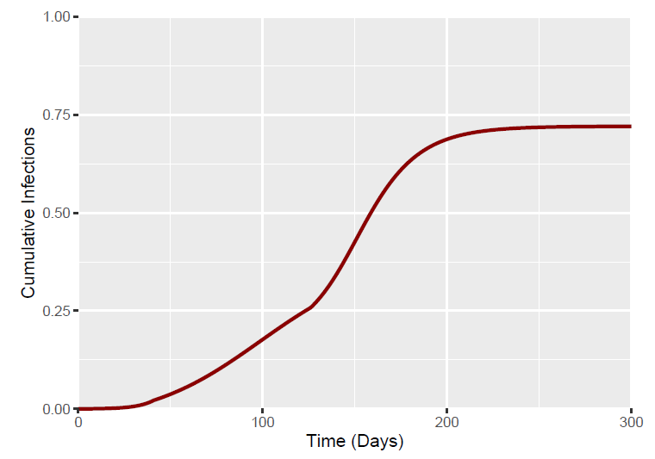
Scenario 1 – Immediate reduction to β (0.625* β) at day 41 for 12 weeks (84 days)
Output Measures | Value
Total Fraction Infected | 0.721
Peak Fraction Infected | 0.071
Time of Epidemic Peak | Day 159
Initial Conditions
S = 0.9999
I = 0.0001
R = 0
Doubling Time = 6
R₀ = 2
β = 0.231
β*0.625 = 0.144
Time of I = 0.01
Day 41 (I = 0.0109)

Slide 4
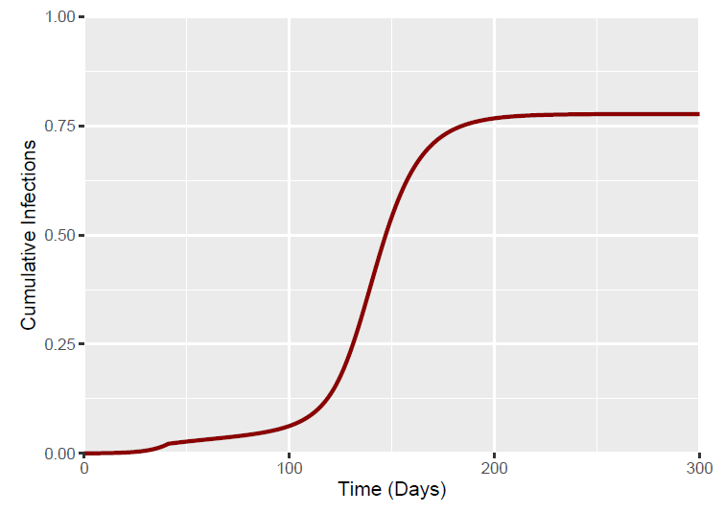
Scenario 2 – Immediate reduction to β at day 41 (0.25* β) – with a linear increase back to baseline after 12 weeks (84 days)
Output Measures | Value
Total Fraction Infected | 0.777
Peak Fraction Infected | 0.127
Time of Epidemic Peak | Day 147
Initial Conditions
S = 0.9999
I = 0.0001
R = 0
Doubling Time = 6
R₀ = 2
β = 0.231
β*0.25 = 0.057
Time of I = 0.01
Day 41 (I = 0.0109)

Slide 5
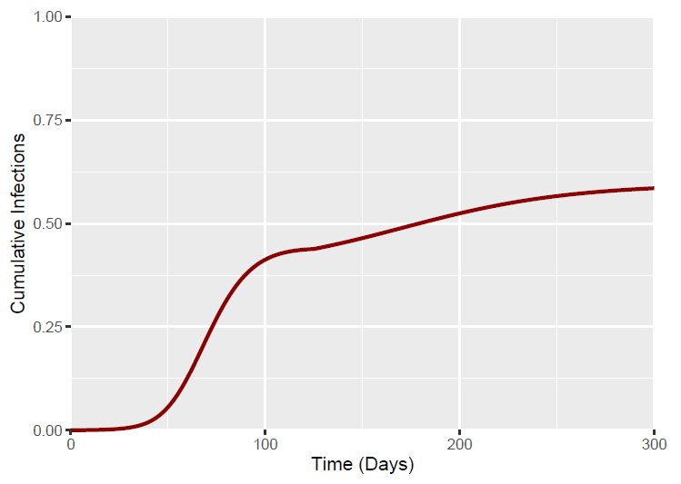
Scenario 3 – Linear decrease to β starting at day 41 – with β reaching 0.25*β at week 12 (84 days) – Immediate return to baseline β after week 12
Output Measures | Value
Total Fraction Infected | 0.585
Peak Fraction Infected | 0.078
Time of Epidemic Peak | Day 76
Initial Conditions
S = 0.9999
I = 0.0001
R = 0
Doubling Time = 6
R₀ = 2
β = 0.231
β*0.25 = 0.057
Time of I = 0.01
Day 41 (I = 0.0109)

Slide 6
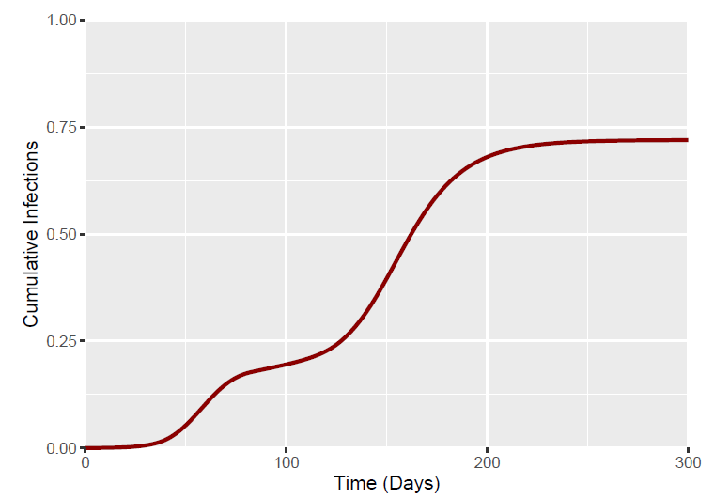
Scenario 4 – Linear decrease to β starting at day 41 – with β reaching 0.25*β at week 6 (42 days).
This is followed by a linear increase to baseline β by week 12 (84 days).
Output Measures | Value
Total Fraction Infected | 0.720
Peak Fraction Infected | 0.070
Time of Epidemic Peak | Day 162
Initial Conditions
S = 0.9999
I = 0.0001
R = 0
Doubling Time = 6
R₀ = 2
β = 0.231
β*0.25 = 0.057
Time of I = 0.01
Day 41 (I = 0.0109)

Slide 7
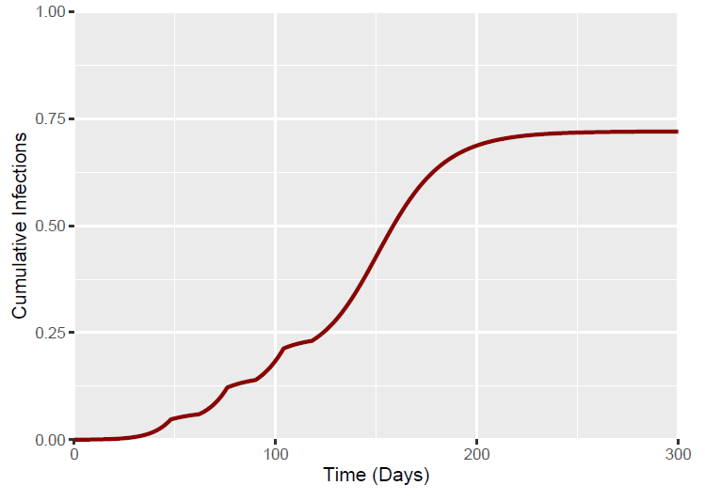
Scenario 5 – 1 week after I = 0.01 (day 41) β “pulses” to 0.25*β for 2 weeks, followed by a return back to baseline β for 2 weeks. This is followed by subsequent 2 week pulses (0.25*β) at 2 week intervals until week 11.
Output Measures | Value
Total Fraction Infected | 0.720
Peak Fraction Infected | 0.070
Time of Epidemic Peak | Day 158
Initial Conditions
S = 0.9999
I = 0.0001
R = 0
Doubling Time = 6
R₀ = 2
β = 0.231
β*0.25 = 0.057
Time of I = 0.01
Day 41 (I = 0.0109)

